Slide 1


Control theory Code
Authors:
Yoav Rozov, Tomy Tochilovsky

Slide 2

Current limits
Source: CTRE docs

Slide 3
Motor Current Limits
Current limiting is the process of restricting motor output when a given current has surpassed a limit. There are two types of current limits available: stator and supply. Each of these limits accomplishes different goals.
It’s important to understand the need for current limits and how they work. When a motor is under a load, it takes an increasing amount of current to continue rotating the shaft of the motor (and by extension the mechanism). The cumulative sum of all the currents in a multi-motor system, such as a robot, may excessively drain batteries, trigger brownout protection, or in the worst case trip breakers.
Notes:
Source: https://pro.docs.ctr-electronics.com/en/latest/docs/hardware-reference/talonfx/improving-performance-with-current-limits.html

Slide 4
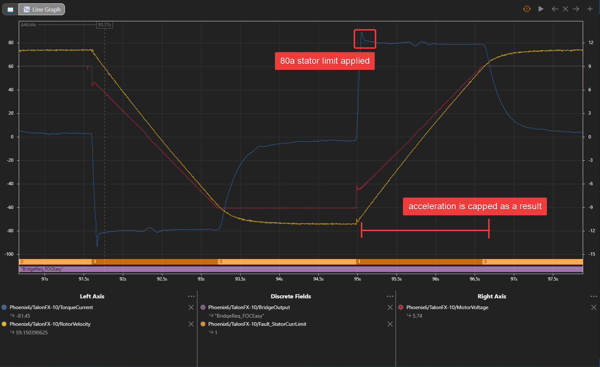
Motor Current Limits
Motor’s supply current MUST be limited by our program.
Stator limits:
Stator current is the output current of the
motor and is directly proportional to torque.
Stator current limits are used to restrict the torque output of the motor. This can be used to prevent wheel slip or avoid damaging a mechanism when running into a hard stop. Supply current will not exceed a stator current limit and is often significantly lower than stator current.
Notes:
More information: https://pro.docs.ctr-electronics.com/en/latest/docs/hardware-reference/talonfx/improving-performance-with-current-limits.html

Slide 5
Motor Current Limits
Supply current:
Supply current is the current drawn from the battery. As a result, limiting supply current can be useful to prevent breakers from tripping, as well as to improve the longevity of the battery.
When the SupplyCurrentThreshold has elapsed for SupplyTimeThreshold amount of time, the supply current limiter will activate and reduce motor output until supply current is within range of the limit.
In the rare case where the robot experiences brownouts despite configuring stator current limits, a supply current limit can also further help avoid brownouts. However, such brownouts are most commonly caused by a bad battery or poor power wiring, so those should be examined first.
Notes:
More information: https://pro.docs.ctr-electronics.com/en/latest/docs/hardware-reference/talonfx/improving-performance-with-current-limits.html

Slide 6
Determining Current Limits
Self learning at home:
CTRE docs
Notes:
URL: https://pro.docs.ctr-electronics.com/en/latest/docs/hardware-reference/talonfx/improving-performance-with-current-limits.html

Slide 7
Code

Slide 8
Important notice!
We use custom made java records that you can download from here.

Slide 9
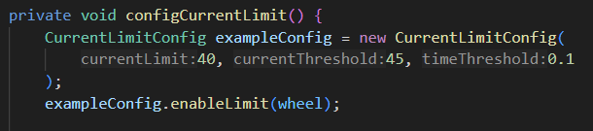
Current limits
Motor current limits MUST be configured through code when we create a subsystem.
The Current limits parameters are configured using a config object: CurrentLimitConfig.
When we want to apply the configuration to a motor controller we will use the following function:
config. enableLimit(motor);
This is only an example; In real code the config objects should be created inside the Constats.java file

Slide 10
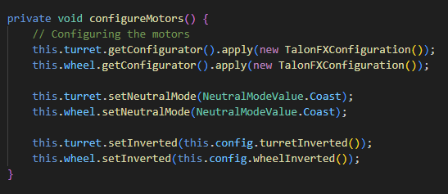
Motor Configuration
Motors should be configured through code when we create a subsystem.
Usually, we configure the following parameters:
NeutralMode – what the motor does when the supplied voltage is 0.
IsInverted – What direction is considered positive for the motor.
Here is an example from the SwerveModule class. this.config.turretInverted() returns a boolean value

Slide 11
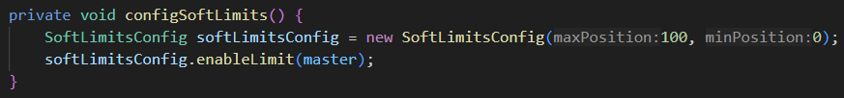
Software limits
Motor soft limits are used to limit the motor’s possible position range.
The soft limits parameters are configured using a config object: SoftLimitsConfig.
When we want to apply the configuration to a specific motor controller we will use the following function:
config. enableLimit(motor)
This is only an example, In real code the config object should be created inside the Constats.java file

Slide 12
Closed loop control

Slide 13

PID
Profile slots - A motor controller has 4 “profile slots”
Each profile slot can hold a different closed loop config, when running the closed loop controller, we need to specify which profile slot it will be using.
PID - The PID parameters are configured using a config object: PIDConfig.
When we want to apply the configuration to a specific profile slot on the motor controller we will use the following function:
config.configProfileSlot(id, motor)
This is only an example; In real code the config object should be created inside the Constats.java file
Notes:
All the config objects have detailed comments and explanations in the code itself

Slide 14
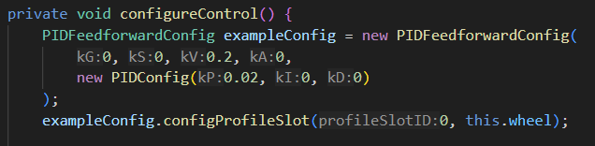
Feedforward + PID
Feedforward - The Feedforward parameters are configured using a config object: PIDFeedforwardConfig.
When we want to apply the configuration to a specific profile slot on the motor controller we will use the following function:
config.configProfileSlot(id, motor)
The feedforward constructor expects the
Kp, Ki, Kd parameters to be passed in as
a PIDConfig object
This is only an example; In real code the config objects should be created inside the Constats.java file
Notes:
All the config objects have detailed comments and explanations in the code itself

Slide 15
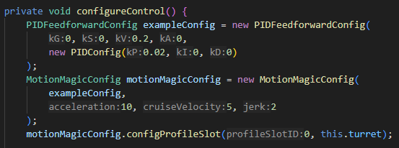
Motion Magic
Motion Magic - The Motion magic parameters are configured using a config object: MotionMagicConfig.
When we want to apply the configuration to a specific profile slot on the motor controller we will use the following function:
config.configProfileSlot(id, motor)
The motion magic constructor expects
all the Feedforward and PID parameters
to be passed in as a PIDFeedforwardConfig
object.
This is only an example; In real code the config objects should be created inside the Constats.java file

Slide 16
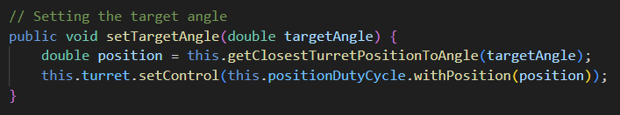
Move motor
Control Types - To control a motor we need to specify the control type, there are 4 main control types we use:
DutyCycleOut - move the motor by a percentage
PositionDutyCycle - move motor by position
VelocityDutyCycle - move motor by velocity
MotionMagicDutyCycle - move motor with motion magic
To control the motor first, declare a class variable of the correct type,
configure a selected slot, apply that slot to the control type (in the constructor)
Finaly, move the motor:

Slide 17
Practice

Slide 18
Create angler subsystem
The angler is controlled with MotionMagicDutyCycle.
Functions:
Private:
configMotors
configControl
configSoftLimits
configCurrentLimits -> 20, 25, 0.1
Public:
stop
moveByPosition
MoveByPercent
resetPosition -> this.master.setPosition(0);
disableLimits
enableLimits
setControlConfig(MotionMagicConfig)
All angler constants should be saved inside the Constants.java file under a new class called AnglerConstants (see DrivetrainConstants as an example)

Slide 19
Create angler commands
Commands:
ResetAnglerPosition -> move by percent until the current exceeds a limit
DebugMoveAnglerToPosition -> use shuffleboard to create a new MotionMagicConfig and apply it in the initialize method
All angler constants should be saved inside the Constants.java file under a new class called AnglerConstants (see DrivetrainConstants as an example)

Slide 20
תודה על ההקשבה

